Slide 1

Let’s start with Allah Yaar
Bs in Computer Science

Slide 2
Networks
Definition:
A network is an interconnected system of devices that share data, resources, and services using communication protocols. Networks are critical for enabling digital communication, file sharing, and access to centralized resources in modern systems.
Key Concepts:
Data Transmission: daNetworks transmit ta in packets using wired or wireless mediums. Protocols like TCP/IP govern this process to ensure reliable and error-free communication.

Slide 3
Networks
Resource Sharing: Devices can share peripherals like printers and data storage, reducing redundancy and improving efficiency.
Importance of Networks:
Globalization: Enables real-time communication and collaboration across continents.
Automation: Forms the backbone of automation in industries, from smart factories to cloud-based services.

Slide 4
Network Devices
a) Router
Definition: A router connects multiple networks and directs data packets between them. It uses routing tables and algorithms to determine the best path for data.
Advanced Features:
NAT (Network Address Translation): Converts private IPs into a public IP for internet communication, enabling multiple devices to share a single connection.
Dynamic Routing Protocols:
OSPF (Open Shortest Path First): Calculates the shortest route based on link states

Slide 5
Network Devices
BGP (Border Gateway Protocol): Manages the exchange of routing information between autonomous systems on the internet.
Dual-Band Routers: Operate on 2.4 GHz and 5 GHz frequencies, optimizing performance for different devices and applications.

Slide 6
Network Devices
Advantages:
Provides network segmentation and enhanced security.
Allows integration with firewalls and VPNs.
Disadvantages:
Expensive, especially for enterprise-grade models.
Configuration can be complex.

Slide 7
Network Interface Card (NIC)
Definition: A NIC is a hardware component that allows a device to connect to a network, acting as the interface between the system's hardware and the network protocols.
Advanced Features:
Full-Duplex Communication: Enables simultaneous sending and receiving of data, doubling throughput.
Wake-on-LAN (WoL): Allows remote devices to wake up from a low-power state.
Virtual NICs: Software-defined NICs used in virtualized environments for dynamic network management.

Slide 8
Network Interface Card (NIC)
Advantages:
Supports high-speed data transfers with modern gigabit or 10-gigabit Ethernet.
Facilitates advanced features like Quality of Service (QoS).
Disadvantages:
Faulty NICs can disconnect the device entirely from the network.
Wireless NICs may face interference, reducing speed and reliability.

Slide 9
Hub
Definition: A hub is a basic device that connects multiple devices in a network, broadcasting data packets to all connected devices.
Advanced Concepts:
Rarely used in modern networks due to inefficiency but may still serve in legacy systems.
Active hubs can amplify signals, improving data transmission in larger networks.

Slide 10
Hub
Advantages:
Simple to set up and cost-effective for small-scale applications.
Disadvantages:
Causes unnecessary traffic and bandwidth usage.
Lacks intelligence to forward data selectively.

Slide 11
Switch
Definition: A switch intelligently connects devices in a network, using MAC addresses to forward data packets directly to the intended recipient.
Advanced Features:
Managed Switches:
VLAN Support: Segments network traffic for improved security and efficiency.
Link Aggregation: Combines multiple network connections to increase bandwidth.
PoE (Power over Ethernet): Delivers power to devices like IP cameras through Ethernet cables.

Slide 12
Switch
Advantages
Reduces network congestion.
Supports scalability and advanced configurations.
Disadvantages
Costlier than hubs.
Requires expertise to configure and manage.

Slide 13
Bridge
Definition: A bridge connects two or more network segments, enabling them to function as a single network while reducing congestion.
Types:
Transparent Bridge: Operates automatically without altering the network’s architecture.
Source Routing Bridge: Uses the packet’s source address to determine the forwarding path.

Slide 14
Bridge
Advantages:
Efficiently manages traffic between segments.
Enhances scalability by extending networks.
Disadvantages:
Limited functionality compared to modern switches.
Can introduce latency if misconfigured.

Slide 15
Wi-Fi
Definition: Wi-Fi provides wireless connectivity using radio waves, supporting devices over a short to medium range.
Advanced Features:
Wi-Fi Standards: E.g., 802.11ax (Wi-Fi 6) offers faster speeds, lower latency, and improved performance in crowded environments.
Mesh Networking: Eliminates dead zones by creating a seamless network using multiple access points.

Slide 16
Wi-Fi
Advantages:
Eliminates the need for cables.
Enables mobility and flexibility.
Disadvantages:
Prone to interference from physical obstructions and other devices.
Security concerns if encryption is weak (e.g., WEP).

Slide 17
Bluetooth
Definition: Bluetooth provides short-range wireless communication between devices for data transfer or peripheral connection.
Advanced Features:
Bluetooth Low Energy (BLE): Optimized for IoT devices, using minimal power.
Improved Audio (Bluetooth 5.3): Offers better sound quality and reduced latency for devices like headphones.

Slide 18
Bluetooth
Advantages:
Energy-efficient for small devices.
Simplifies connections between personal devices.
Disadvantages:
Limited range and data transfer speed compared to Wi-Fi.
Susceptible to interference in crowded environments.

Slide 19
Cloud Computing
Definition: Cloud computing provides on-demand access to computing resources, including storage, servers, and applications, over the internet.
Types:
Public Cloud: Shared resources, cost-effective but less secure.
Private Cloud: Dedicated resources for enhanced security and customization.
Hybrid Cloud: Combines public and private clouds for flexibility.

Slide 20
Cloud Computing
Advantages:
Scalable and flexible, allowing businesses to pay only for what they use.
Enables remote access and collaboration.
Disadvantages:
Reliance on internet connectivity.
Security and privacy concerns with sensitive data.

Slide 21
Network Types
LAN (Local Area Network)
Connects devices in a small geographic area, such as an office or school.
High speed and low cost make it ideal for resource sharing and communication.
WAN (Wide Area Network)
Interconnects multiple LANs over large distances, like cities or countries.
Uses technologies like MPLS (Multiprotocol Label Switching) for efficient routing.

Slide 22
Cloud Computing
MAN (Metropolitan Area Network)
Spans a city or campus, connecting multiple LANs for broader coverage.
Often managed by governments or ISPs.
PAN (Personal Area Network)
Connects personal devices, such as smartphones and wearables, within a short range.
Common technologies include Bluetooth and Infrared.

Slide 23
Effects of Networks
Advantages:
Collaboration: Real-time collaboration using platforms like Microsoft Teams.
Cost Savings: Shared resources reduce hardware costs.
Centralized Management: Simplifies data control and security monitoring.
Disadvantages:
Cybersecurity Risks: Networks are vulnerable to hacking, data breaches, and malware.
Downtime: Network failure can disrupt entire systems, especially in businesses.
Environmental Impact: Data centers consume significant energy, though renewable energy usage is improving.

Slide 24
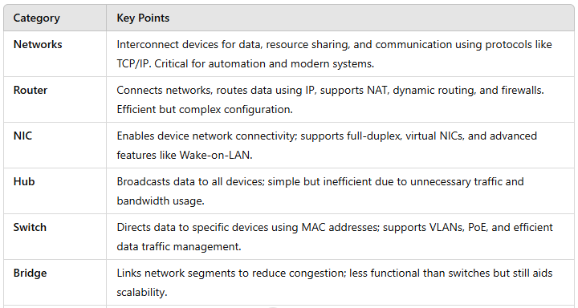
Summary Table

Slide 25
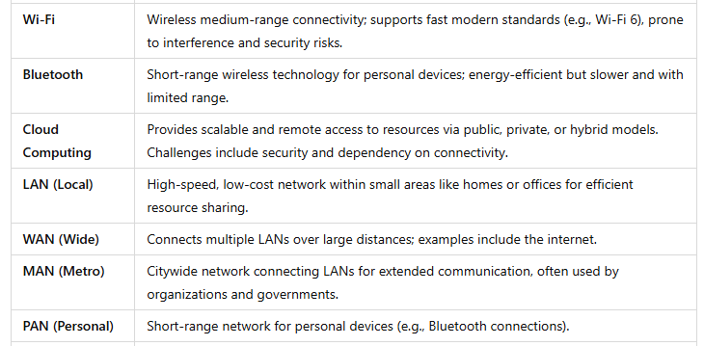
Summary Table

Slide 26
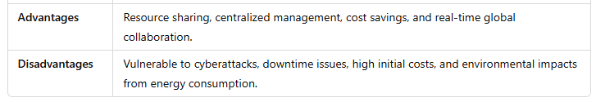
Summary Table

